Slide 1
PowerLine Laser Markers - Overview

Slide 2
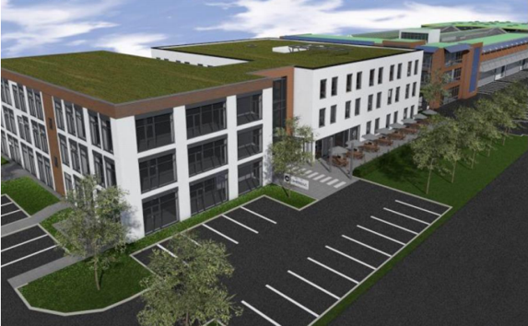
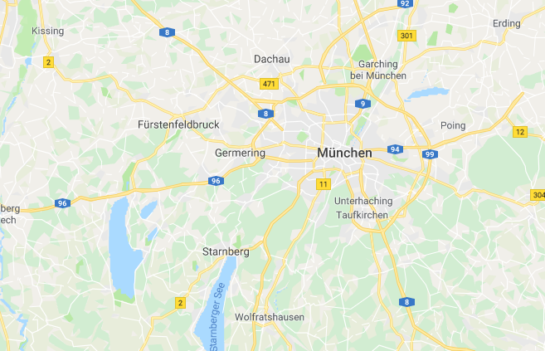
Introduction
Laser sub-systems for laser marking
25+ years of experience serving the semiconductor, electronics, automotive, medical and other industries
Well established partnerships with many integrators
We are committed to the success of our customers and offer engineering and software support
Strong global sales and service support team
Excellent application know-how
Gilching Facilities
Gilching

Slide 3
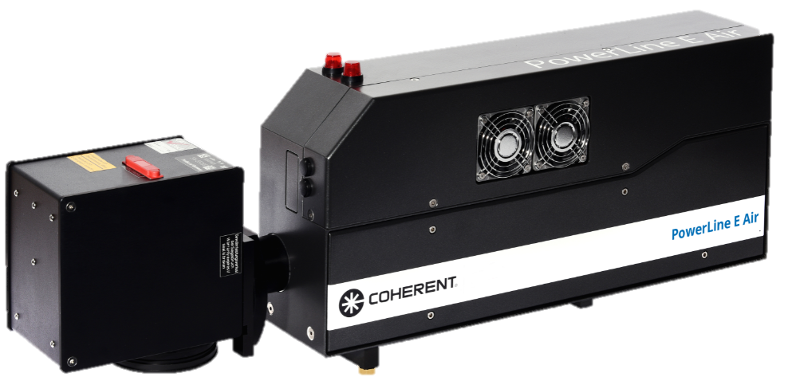
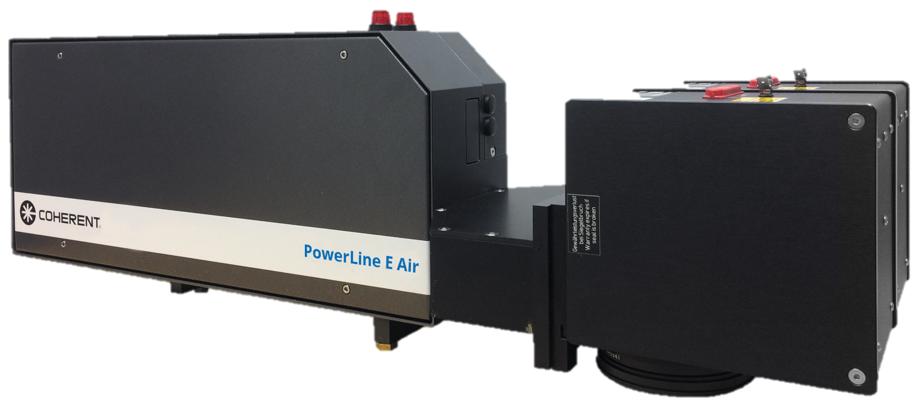
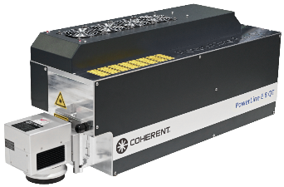
PowerLine E Laser Markers (air-cooled)
1,064 nm
1,064 nm
1,064 nm
6 W
18 W
20 W
PL E Air 10-1064
Wavelength | 1,064 nm
Average power | 6 W (20 kHz)
Frequency | cw, 0 – 200 kHz
Pulse width | 10 ns (20 kHz)
Beam quality M² | 1.5
Pilot laser | Optional
Internal power meter | Optional
Cooling | Air cooling
Length (laser head) | 500 mm
PL E Air 25-1064
Wavelength | 1,064 nm
Average power | 18 W (20 kHz)
Frequency | cw, 0 – 200 kHz
Pulse width | 20 ns (20 kHz)
Beam quality M² | 1.3
Pilot laser | Optional
Internal power meter | Optional
Cooling | Air cooling
Length (laser head) | 500 mm
PL E Air 30-1064
Wavelength | 1,064 nm
Average power | 20 W (60 kHz)
Frequency | cw, 0 – 200 kHz
Pulse width | 40 ns (60 kHz)
Beam quality M² | 2 - 4
Pilot laser | Optional
Internal power meter | Optional
Cooling | Air cooling
Length (laser head) | 500 mm
NEW
532 nm
NEW
532 nm
355 nm
6 W
12 W
6 W
PL E 6 QS
Wavelength | 532 nm
Average power | 6 W (50 kHz)
Frequency | 5 – 200 kHz
Beam quality M² | 1.5
Pulse width | 40 ns (50 kHz)
Pilot laser | Optional
Internal power meter | Optional
Cooling | Air cooling
Length (laser head) | 500 mm
PL E 12 QS
Wavelength | 532 nm
Average power | 12 W (50 kHz)
Frequency | 15 – 200 kHz
Beam quality M² | 1.5
Pulse width | 25 ns (50 kHz)
Pilot laser | Optional
Internal power meter | Optional
Cooling | Air cooling
Length (laser head) | 500 mm
PL E 8 QT (AC)
Wavelength | 355 nm
Average power | > 6 W
Frequency | Up to 135 kHz
Pulse width | 25 ns
Beam quality M² | 1.2
Pilot laser | Yes
Internal power meter | Yes
Cooling | Air cooling
Length (laser head) | 688 mm

Slide 4
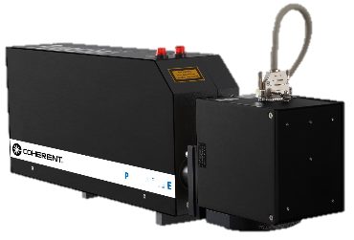
PowerLine E Laser Markers (water-cooled)
1,064 nm
1,064 nm
355 nm
20 W
35 W
2 W
PL E 30
Wavelength | 1,064 nm
Average power | 20 W (60 kHz)
Frequency | cw, 0 – 200 kHz
Pulse width | 40 ns (60 kHz)
Beam quality M² | 2 - 4
Pilot laser | Optional
Internal power meter | Optional
Cooling | Water/air-cooling
Length (laser head) | 500 mm
PL E 40
Wavelength | 1,064 nm
Average power | 35 W (60 kHz)
Frequency | cw, 30 – 200 kHz
Pulse width | 35 ns (60 kHz)
Beam quality M² | 2 - 4
Pilot laser | Optional
Internal power meter | Optional
Cooling | Water/air-cooling
Length (laser head) | 600 mm
PL E 20 THG
Wavelength | 355 nm
Average power | 2 W (15 kHz)
Frequency | 15 – 100 kHz
Pulse width | 10 ns (15 kHz)
Beam quality M² | 1.5
Pilot laser | No
Internal power meter | Only for IR
Cooling | Water cooling
Length (laser head) | 500 mm
532 nm
532 nm
532 nm
6 W
12 W
18 W
PL E 12 SHG
Wavelength | 532 nm
Average power | 6 W (50 kHz)
Frequency | 5 – 200 kHz
Beam quality M² | 1.5
Pulse width | 40 ns (50 kHz)
Pilot laser | Optional
Internal power meter | Optional
Cooling | Water/air-cooling
Length (laser head) | 500 mm
PL E 20 SHG IC
Wavelength | 532 nm
Average power | 12 W (50 kHz)
Frequency | 15 – 200 kHz
Beam quality M² | 1.5
Pulse width | 25 ns (50 kHz)
Pilot laser | Optional
Internal power meter | Optional
Cooling | Water/air-cooling
Length (laser head) | 500 mm
PL E 25 SHG
Wavelength | 532 nm
Average power | 18 W (50 kHz)
Frequency | 15 – 200 kHz
Beam quality M² | 1.5
Pulse width | 32 ns (50 kHz)
Pilot laser | Optional
Internal power meter | Optional
Cooling | Water/air-cooling
Length (laser head) | 600 mm

Slide 5
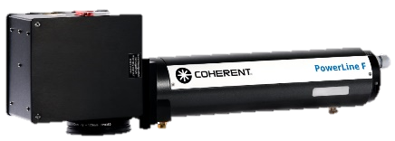
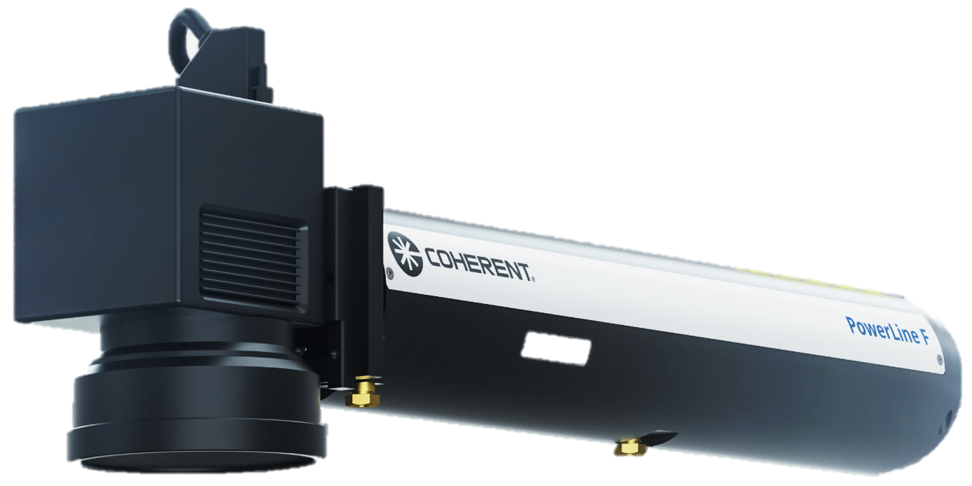
PowerLine F / Fiber Laser Markers
1,060 nm
1,060 nm
1,060 nm
PL F 20-1064
Wavelength | 1,060 - 1,070 nm
Average power | 19 W
Frequency | 20 – 100 kHz
Pulse width | 100 ns (20 kHz)
Beam quality M² | 2.0
Pilot laser | Yes
Internal power meter | No
Cooling | Air cooling
Length (laser head) | 594 mm
PL F 30-1064
Wavelength | 1,060 - 1,070 nm
Average power | 28 W
Frequency | 30 – 100 kHz
Pulse width | 100 ns (30 kHz)
Beam quality M² | 2.0
Pilot laser | Yes
Internal power meter | No
Cooling | Air cooling
Length (laser head) | 594 mm
PL F 50-1064
Wavelength | 1,060 - 1,070 nm
Average power | 48 W
Frequency | 50 – 200 kHz
Pulse width | 120 ns (50 kHz)
Beam quality M² | 2.0
Pilot laser | Optional
Internal power meter | No
Cooling | Air cooling
Length (laser head) | 594 mm
1,060 nm
1,060 nm
1,060 nm
PL F 100-1064
Wavelength | 1,060 - 1,070 nm
Average power | 95 W
Frequency | 5.1 – 200 kHz
Pulse width | 100 ns (100 kHz)
Beam quality M² | 2.0
Pilot laser | Optional
Internal power meter | No
Cooling | Air cooling
Length (laser head) | 594 mm
PL F 20 Varia
Wavelength | 1,060 - 1,070 nm
Average power | 19
Frequency | 2 – 1,000 kHz
Pulse width | 4 – 200 ns
Beam quality M² | 2.0
Pilot laser | Optional
Internal power meter | No
Cooling | Air cooling
Length (laser head) | 594 mm
PL F 50 Varia
Wavelength | 1,060 - 1,070 nm
Average power | 47 W
Frequency | 2 – 1,000 kHz
Pulse width | 1 - 120 ns
Beam quality M² | 2.0
Pilot laser | Optional
Internal power meter | No
Cooling | Air cooling
Length (laser head) | 594 mm

Slide 6
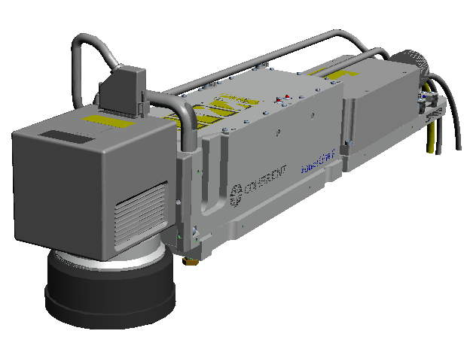
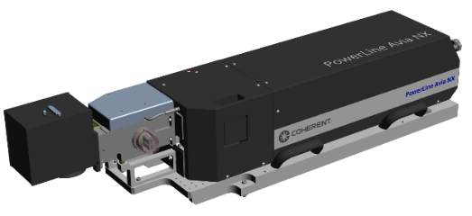
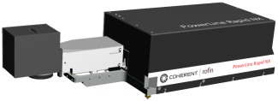
Special Laser Marking Sub-Systems
Green Fiber Laser
NEW
Ultrashort pulse
1,064 nm
532 nm
355 nm
7 W
40 W
PL Rapid NX 10-1064
Wavelength | 1064 nm
Average power | 7 W
Frequency | 50 – 1,000 kHz
Pulse width | < 15 ps
Beam quality M² | 1.3
Pilot laser | Yes
Internal power meter | No
Cooling | Water/air cooling
Length (laser head) | 617 mm
PL F 10 QS
Wavelength | 532 nm
Average power | 9 W
Frequency | 10 – 250 kHz
Pulse width | 1.5 ns
Beam quality M² | 1.2
Pilot laser | Yes
Internal power meter | No
Cooling | Air cooling
Length (laser head) | 831 mm
PL AVIA NX 20 / 40 - 355
Wavelength | 355 nm
Average power | 20 W / 40 W
Frequency | 1 – 250 kHz
Pulse width | 30 ns
Beam quality M² | 1.2
Pilot laser | Yes
Internal power meter | Yes
Cooling | Water cooling
Length | 1,245 mm

Slide 7
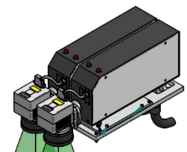
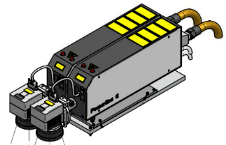
PowerLine E Twin Overview
1,064 nm
1,064 nm
1,064 nm
532 nm
2x
18 W
2x
20 W
2x
35 W
2x
6 W
PL E 25-1064 T
Wavelength | 1,064 nm
Average power | 2 x 18 W (20 kHz)
Frequency | cw, 0 – 200 kHz
Pulse width | 20 ns (20 kHz)
Beam quality M² | 1.3
Pilot laser | Optional
Internal power meter | Optional
Cooling | Water / Air
Length (laser head) | 500 mm
PL E 30-1064 T
Wavelength | 1,064 nm
Average power | 2 x 20 W (60 kHz)
Frequency | cw, 0 – 200 kHz
Pulse width | 40 ns (60 kHz)
Beam quality M² | 2 - 4
Pilot laser | Optional
Internal power meter | Optional
Cooling | Water / Air
Length (laser head) | 500 mm
PL E 40-1064 T
Wavelength | 1,064 nm
Average power | 2 x 35 W (60 kHz)
Frequency | cw, 30 – 200 kHz
Pulse width | 35 ns (60 kHz)
Beam quality M² | 2 - 4
Pilot laser | Optional
Internal power meter | Optional
Cooling | Water / Air
Length (laser head) | 600 mm
PL E 12-532 T
Wavelength | 532 nm
Average power | 2 x 6 W (50 kHz)
Frequency | 5 – 200 kHz
Beam quality M² | 1.5
Pulse width | 40 ns (50 kHz)
Pilot laser | Optional
Internal power meter | Optional
Cooling | Water / Air
Length (laser head) | 500 mm
532 nm
532 nm
355 nm
2x
12 W
2x
18 W
2x
2 W
PL E 20-532 T
Wavelength | 532 nm
Average power | 2 x 12 W (50 kHz)
Frequency | 15 – 200 kHz
Beam quality M² | 1.5
Pulse width | 25 ns (50 kHz)
Pilot laser | Optional
Internal power meter | Optional
Cooling | Water / Air
Length (laser head) | 500 mm
PL E 25-532 T
Wavelength | 532 nm
Average power | 2 x 18 W (50 kHz)
Frequency | 15 – 200 kHz
Beam quality M² | 1.5
Pulse width | 32 ns (50 kHz)
Pilot laser | Optional
Internal power meter | Optional
Cooling | Water / Air
Length (laser head) | 600 mm
PL E 20-355
Wavelength | 355 nm
Average power | 2 x 2 W (15 kHz)
Frequency | 15 – 100 kHz
Pulse width | 10 ns (15 kHz)
Beam quality M² | 1.5
Pilot laser | No
Internal power meter | Only for IR
Cooling | Water / Air
Length (laser head) | 500 mm

Slide 8
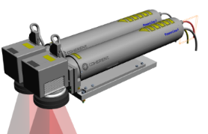
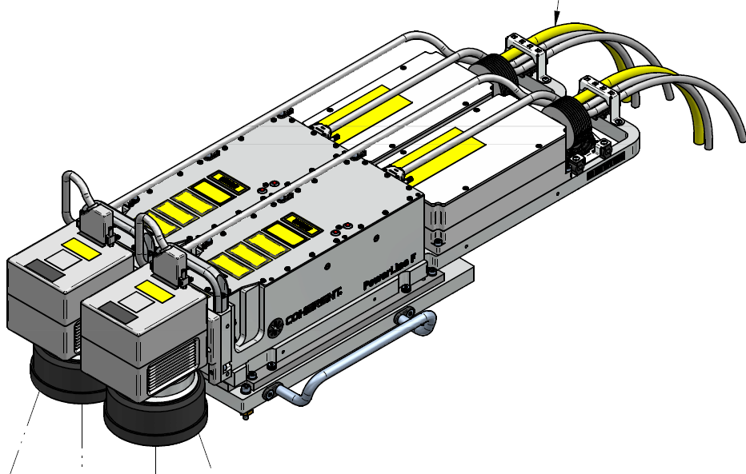
PowerLine F Twin Overview
1,064 nm
1,064 nm
1,064 nm
2x
19 W
2x
28 W
2x
48 W
PL F 20-1064 T
Wavelength | 1,060 - 1,070 nm
Average power | 2 x 19 W
Frequency | 20 – 100 kHz
Pulse width | 100 ns (20 kHz)
Beam quality M² | 2.0
Pilot laser | Yes
Internal power meter | No
Cooling | Air
Length (laser head) | 594 mm
PL F 30-1064 T
Wavelength | 1,060 - 1,070 nm
Average power | 2 x 28 W
Frequency | 30 – 100 kHz
Pulse width | 100 ns (30 kHz)
Beam quality M² | 2.0
Pilot laser | Yes
Internal power meter | No
Cooling | Air
Length (laser head) | 594 mm
PL F 50-1064 T
Wavelength | 1,060 - 1,070 nm
Average power | 2 x 48 W
Frequency | 50 – 200 kHz
Pulse width | 120 ns (50 kHz)
Beam quality M² | 2.0
Pilot laser | Yes
Internal power meter | No
Cooling | Air
Length (laser head) | 594 mm
1,064 nm
1,064 nm
532 nm
2x
19 W
2x
47 W
PL F 20 Varia T
Wavelength | 1,060 - 1,070 nm
Average power | 2 x 19
Frequency | 2 – 1,000 kHz
Pulse width | 4 – 200 ns *)
Beam quality M² | 2.0
Pilot laser | Yes
Internal power meter | No
Cooling | Air
Length (laser head) | 594 mm
PL F 50 Varia T
Wavelength | 1,060 - 1,070 nm
Average power | 2 x 47 W
Frequency | 2 – 1,000 kHz
Pulse width | 1 - 120 ns *)
Beam quality M² | 2.0
Pilot laser | Yes
Internal power meter | No
Cooling | Air
Length (laser head) | 594 mm
PL F 10 QS T
Wavelength | 532 nm
Average power | 2 x 9 W
Frequency | 10 – 250 kHz
Pulse width | 1.5 ns
Beam quality M² | 1.2
Pilot laser | Yes
Internal power meter | No
Cooling | Air
Length (laser head) | 831 mm
*) Pulse width is set in the factory. Pulse width cannot be modified in the field

Slide 9
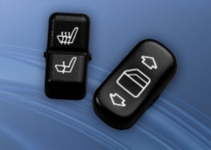
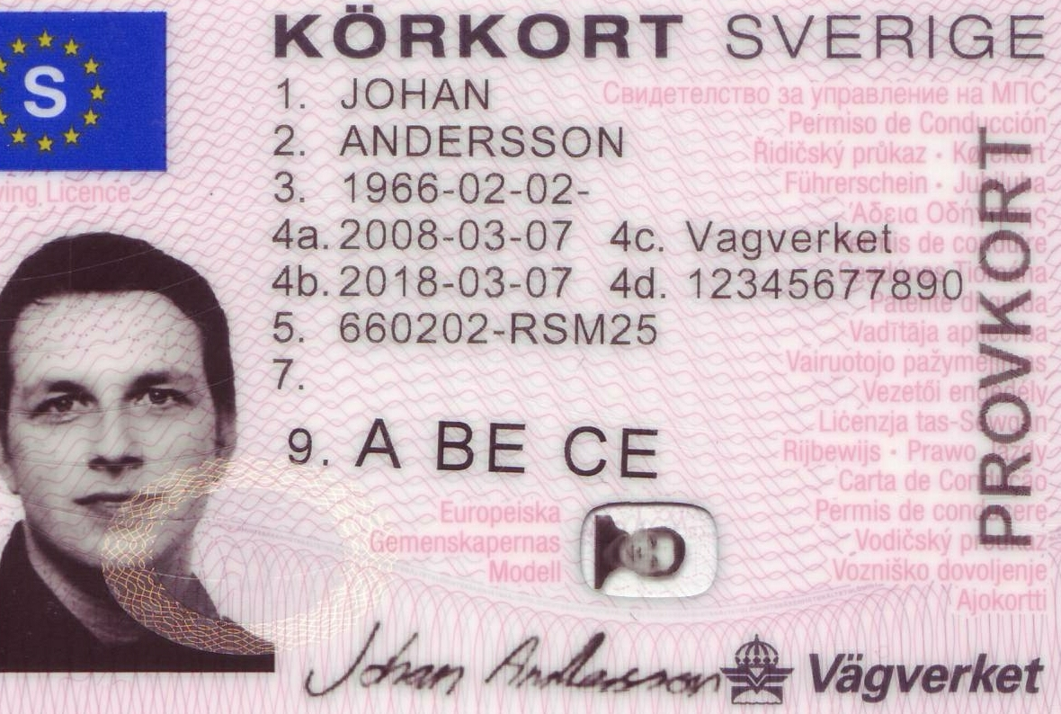
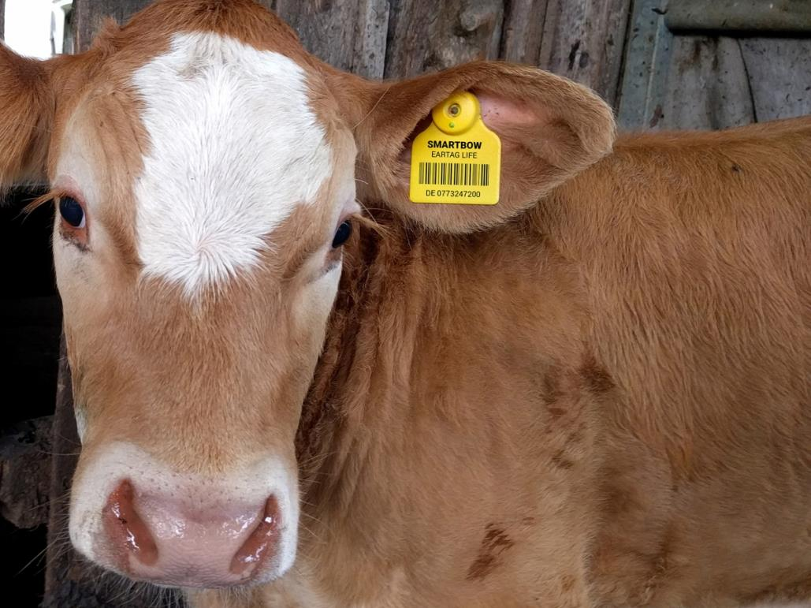
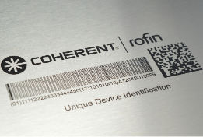
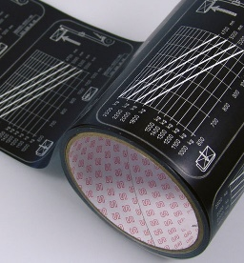
Application Matrix – Laser Marking
λ = 1,064 nm
λ = 532 nm
λ = 355 nm
 | PL Prime 12 / 15 | PL E Air 10 -1064 | PL E Air 25 -1064 | PL E Air 30 -1064 | PL E 40 - 1064 | PL Rapid NX 10 | PL F 20-1064 | PL F 30-1064 | PL F 50-1064 | PL F 100-1064 | PL F 20 Varia | PL F 50 Varia | PL E 12 - 532 | PL E 20 -532 | PL E 25 – 532 | PL E 20 - 355 | PL E 8 QT
Semiconductor ICs |  |  | ● | ● | ● |  | ● | ● | ● |  | ● |  | ● | ● | ●
Plastic Marking (Carbonization) |  |  | ● |  |  |  | ● | ● | ● |  | ● | ●
Plastic Marking (Foaming) | ● | ● | ● |  |  |  | ● | ● | ● |  | ● | ●
Plastic Marking (Bleaching) |  |  |  |  |  |  |  |  |  |  |  |  |  |  |  | ● | ●
PEEK, PA 6, Nylon |  |  |  |  |  |  |  |  |  |  |  |  |  | ● | ● | ● | ●
Ear Tags |  |  |  |  |  |  |  |  |  | ●
Day and Night Design |  |  | ●
Greyscale Marking | ● |  | ●
Metal Marking & Engraving |  |  |  |  |  |  | ● | ● | ● | ● | ● | ●
Copper Marking |  |  |  |  |  |  |  |  |  |  |  |  |  |  | ●
Annealing Marking | ● |  |  |  |  |  |  |  |  |  | ● | ●
SUS Black Marking |  |  |  |  |  | ●
Glass Marking |  |  |  |  |  |  |  |  |  |  |  |  |  | ● |  | ● | ●
Label Marking / Cutting |  |  |  |  |  |  |  | ● | ●
This is only a rough guideline

Slide 10
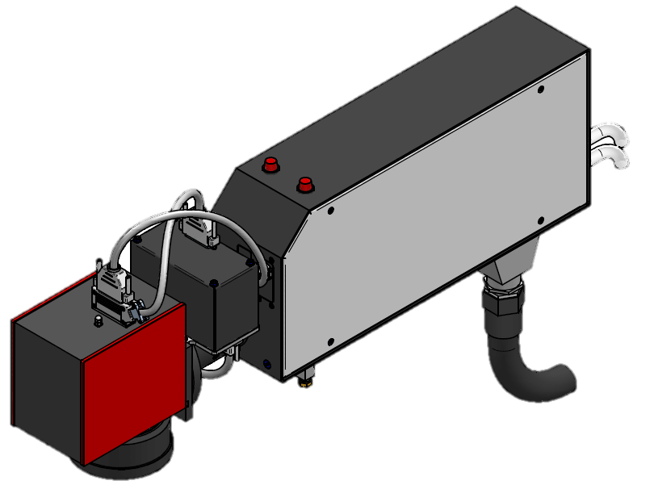


SmartMap3D for Marking of Freeform Objects
Pre-defined standard 3D models:
Plane, sphere, cylinder, cone, cuboid
Adjustable physical dimensions and orientations
Common file types of 3D models are supported: .step, .stp, .igs, .stl, .3ds, .obj
3D viewer displays relative position of laser marker, marking area and 3D model
Within the 3D viewer the 3D model can be shifted or rotated to match position of model and physical object
Preview of marking layout on 3D model
Physical axis in the machine and logical axis in the viewer can be linked
Automatic mapping between 2D marking layout and surface of 3D model
Fast Focus Module
+ 100 %
0 %
Focus range
- 100 %

Slide 11
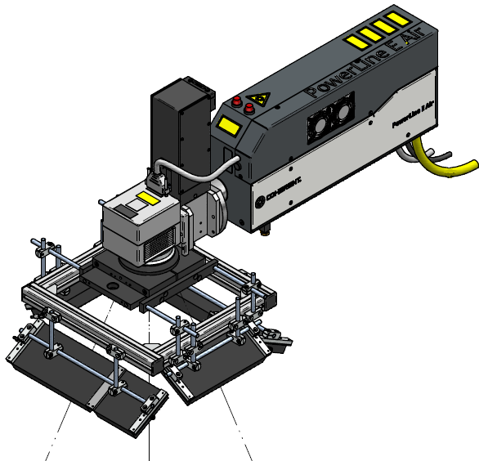
PartVision (On-Axis Camera Alignment)
PartVision offers in-situ, on-axis camera view of work piece
Work piece is viewed through scanner and F-theta lens.
Illumination choices: 1-channels, 8-channel (ring light) and large panel illumination
Three different packages:
PartVision Basic (only IR) – 1-channel illumination
PartVision Advanced (IR, green, UV) – Ringlight illumination
PartVision Advanced+ (only IR) – Large Panel illumination
LaserFrameWork software suite
Camera
Vision Cube
Illumination

Slide 12
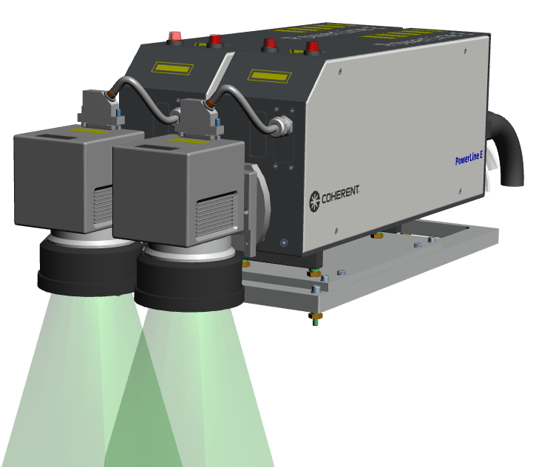
PowerLine E Twin Markers
Two co-operating laser markers for marking one workpiece
One marking layout and one marking recipe
Soft and hardware interfaces like single marker
Reduces total marking time by up to 50% without important design changes of handling system
Uses Coherent’s standard VLM editor and user interface
Supports the Matrix-Object software feature for efficient marking of serialization or traceability codes
To the outside world a Twin is like one laser marker, as easy to integrate while offering an enlarged marking field together with significantly higher throughput

Slide 13
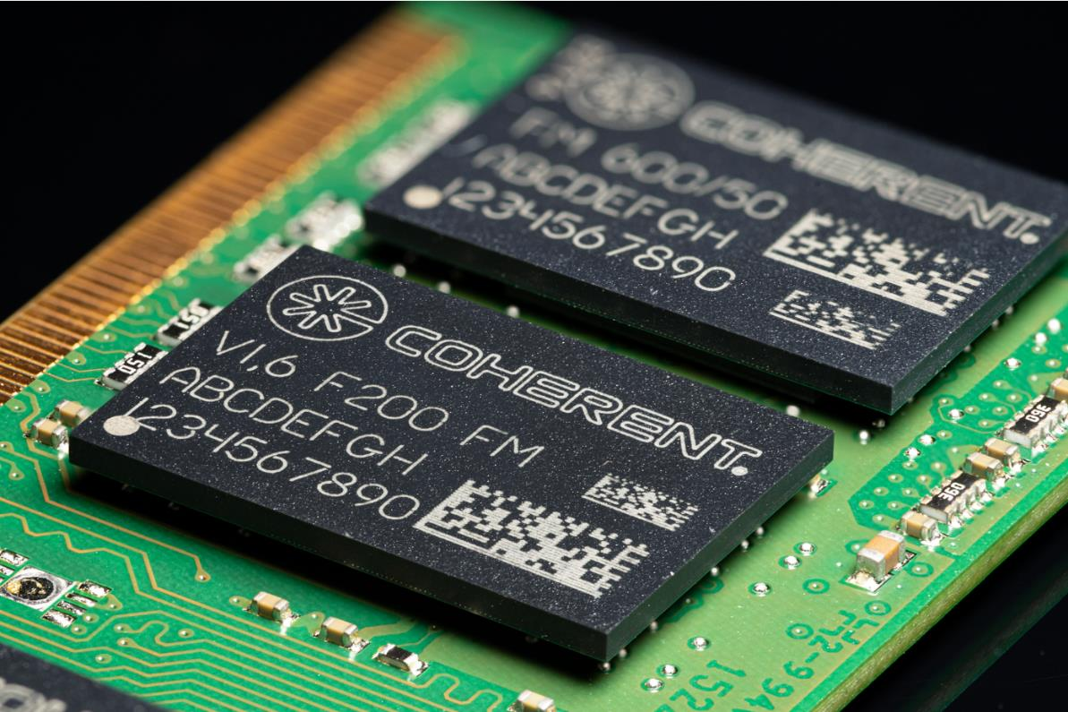
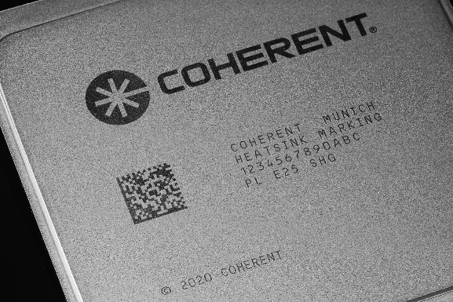
New: SmartProtect Technology
For semiconductor devices with:
Very thin mold compound encapsulation
IC substrates with thin laminated solder stop layers
Dark marking of heat spreaders
For IR, green and UV laser markers
Gaussian Profile
SmartProtect Profile
d
d

Slide 14
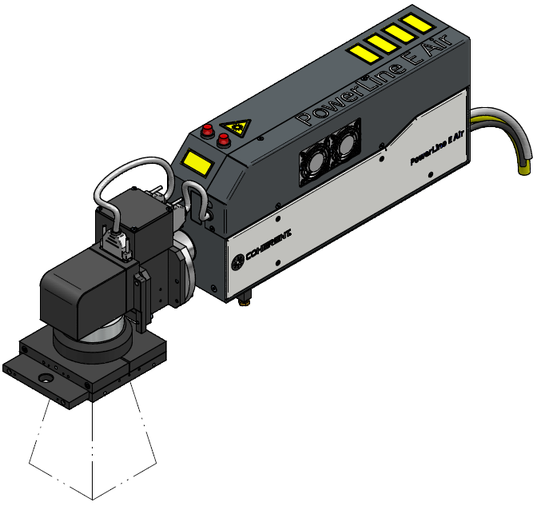
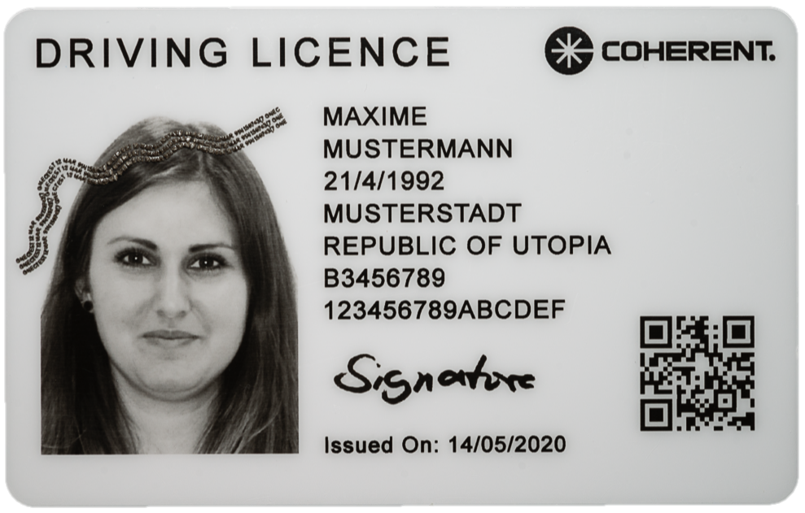
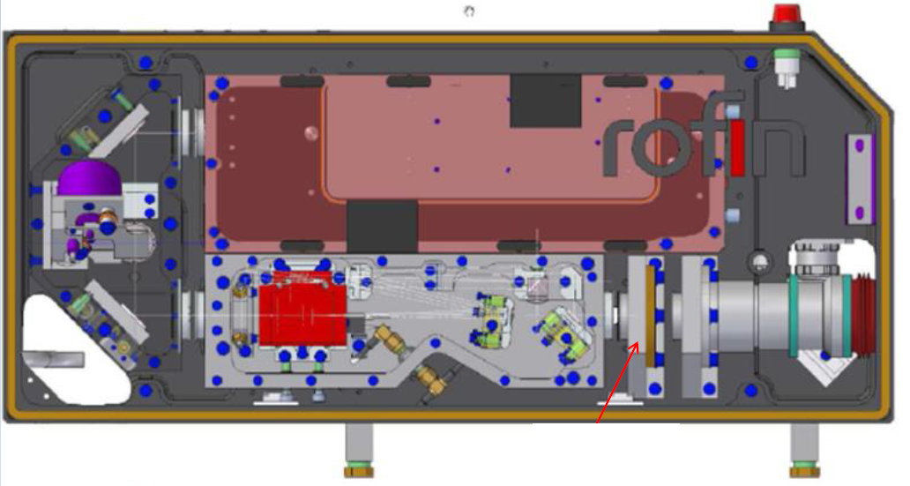



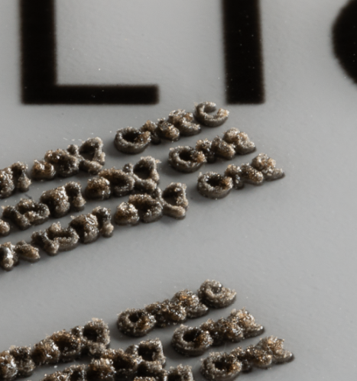
SmartBitmapID: Grayscale Marking
PowerLine E 25-1064 EM
EM = external modulator
Pilot
Resonator
Modulator
Special resonator optimized for for very high pulse stability at 24 W and f > 50 kHz
Internal q-switch modulates only continous sequence of equal laser pulses
External modulator modulates pulse according to gray values.
Enables marking of high contrast, high precision bitmaps. No first-pulse issues.
High-contrast gray values
High-precision black
Tactile features

Slide 15
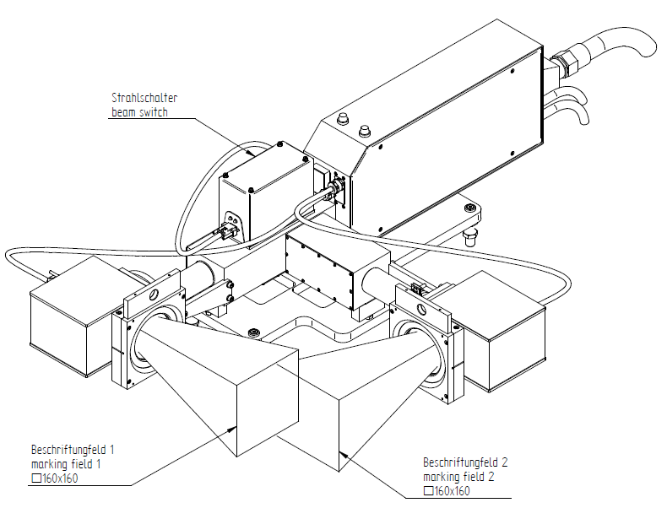
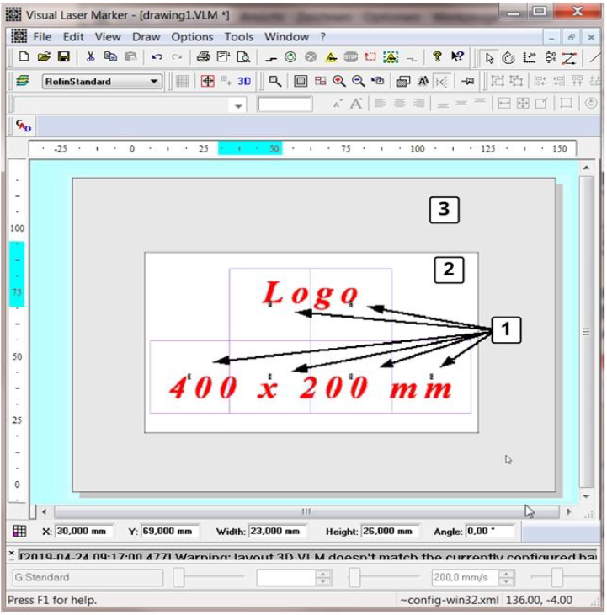
Multistep Marking Sequences
Beam switch with 2 scanners
Visual Laser Marker (VLM) enables the marking of objects in multiple steps
Linear axis, rotary axis, beam switch can be controlled by the laser marker
Marking-on-the-Fly with linear or rotary axis possible
Precision drives and precision field correction allow accurate stiching
Easy programming using VLM editor
Stitching of multiple marking fields

Slide 16
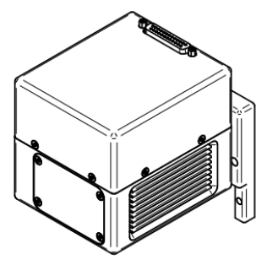
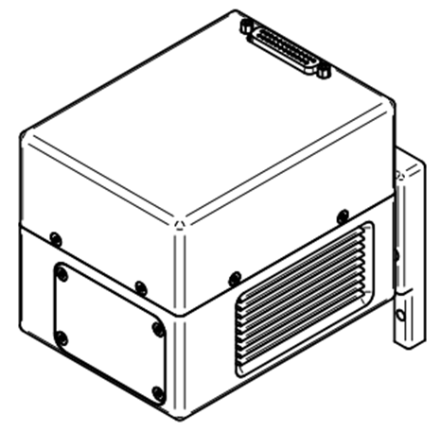
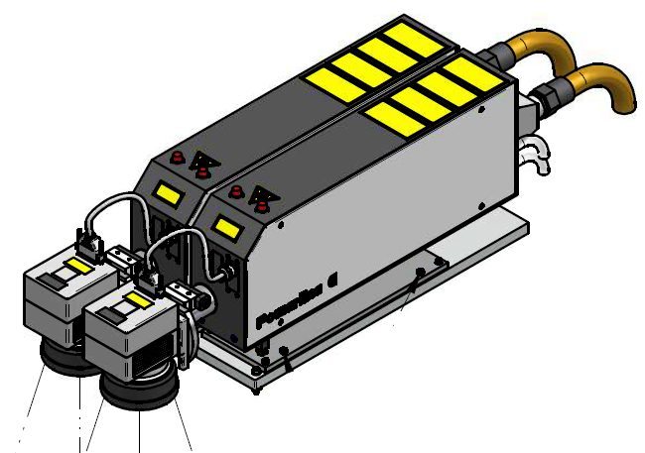
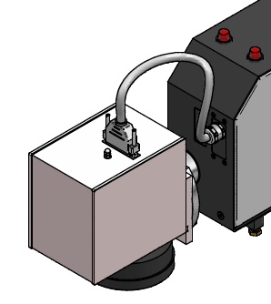
SC10 and SC14 Galvo Scanners
SC10 and SC14: New standard scanners
Successors of S10 and S14 scanners
Significantly improved drift behavior
SC10 has lower dither than S10
Smaller form factor than S10/S14
Mechanical G4 interface for easy retrofit to our installed base of laser markers
For 1,064 nm, 532 nm and 355 nm
ASC (auto-self-calibration) function not needed anymore
In many cases SC10 and SC14 will now fit applications which previously required intelliSCAN scanners
SC 10
SC 14
SC 10
S 10/S14
intelliSCAN SE/SE

Slide 17
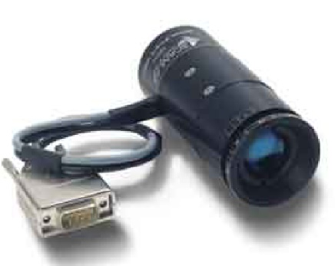
Fast Focusing Module
Mounted between laser head and scanner
Internal expansion factor of 2.8x (1,064 nm) and 4.1x (532 nm)
Fast adjustment of focus z-position
In-focus marking of uneven workpieces
Out-of-focus marking for optimization of linewidth and contrast
Automatic correction of scales when shifting z-Position
Allows simultaneous z-shifting during marking
Fast Focus Module
Z-travel | 1,064 nm | 532 nm | max Δz/Δt
Internal factor | 2.8 x | 4.1 x
f-100 mm | ± 1.5 mm | ± 1.5 mm | 0.2 mm/ms
f-160 mm | ± 4.5 mm | - | 0.6 mm/ms
f-170 mm | ± 5.0 mm | ± 5.0 mm | 0.6 mm/ms
f-255 mm | ± 12.5 mm | ± 12.5 mm | 1.5 mm/ms
f-330 mm | - | ± 21.0 mm | 2.6 mm/ms
f-350 mm | ± 24.0 mm | - | 2.9 mm/ms
f-420 mm | ± 35.0 mm | ± 35.0 mm | 4.2 mm/ms
+ 100 %
0 %
Focus range
- 100 %

Slide 18
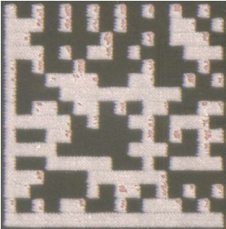
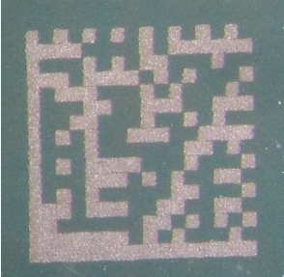
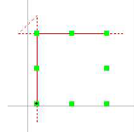
Sky Marking
No acceleration / deceleration of scanner mirrors with open q-switch
Very precise synchronization of gate signal and galvo mirror position
Advantages:
More uniform marking depth
Enables marking of sharp corners
Standard
scan
speed
gate signal
time
Sky Marking
scan
speed
gate signal
beam on
beam off
time
conventional marking
= exposed copper
Sky Marking
= no exposed copper

Slide 19
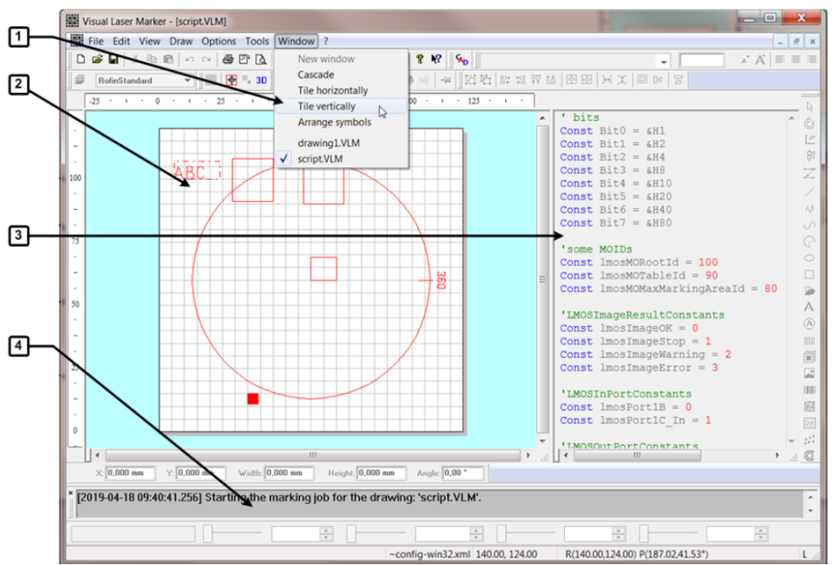
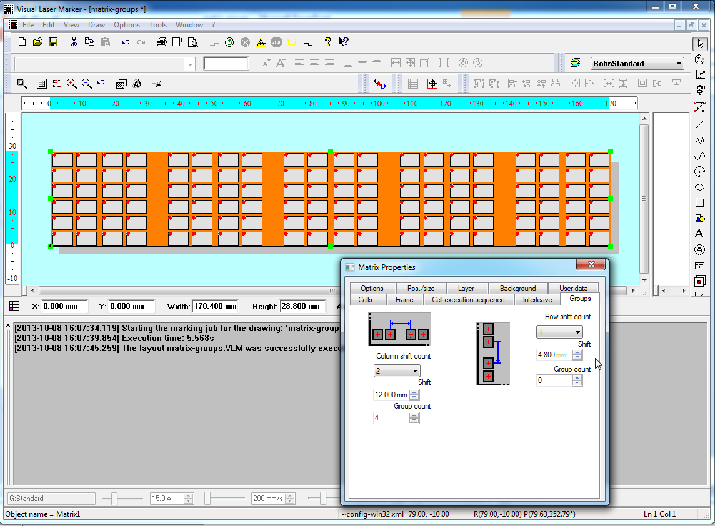
Visual Laser Marker (VLM)
Object-oriented graphic editor
Various object types including polylines, curves, rectangles, circles, barcodes, matrix codes, bitmaps, text.
Flexible programming of hatched objects for optimal marking results
Font editor included. Pre-defined text fonts including intersection-free fonts are available
Bitmaps can be imported with .bmp, .jpg, .jpeg, .gif, .tiff and .png format
Laser parameters can be assigned to marking objects (laser power, scanner speed, beam on/off delays, etc.)
Global assignment of laser parameters for easy set-up of new marking recipes
Local assignment of laser parameters (stored in VLM file) to simplify marking identical designs onto different materials
Assignment of laser parameters for individual objects within a VLM file in order to optimize marking results
Accurate stitching of marking features when objects are positioned by x- and / or y-axis
Laser power calibration and laser power feedback control (requires power sensor)
Navigation
Drawing Window
Scrip Window
Message Window

Slide 20
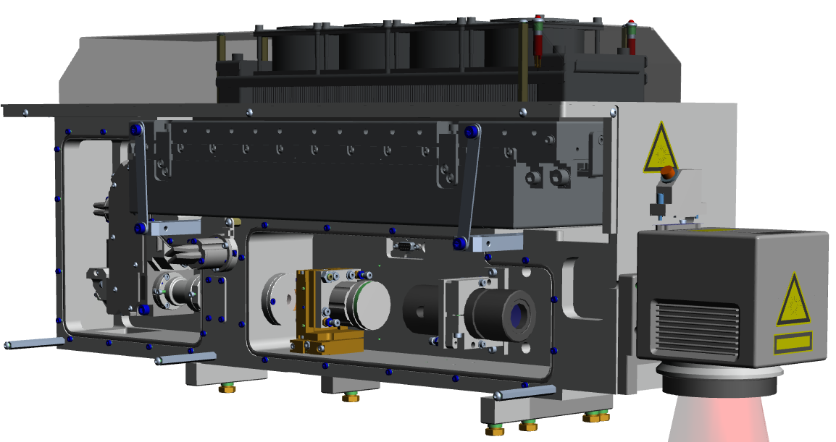
Important Design Elements of PowerLine Laser Markers
Cooling method
Air cooling is most cost-effective while water/air cooling offers best marking control, especially in non air-conditioned environments.
Internal Power Sensor
Monitors laser power to ensure power stability over time (VLM feature)
Mechanical Safety Shutter
Standard feature needed for safe operation of the laser marker
Laser Source
Wavelength and pulse width define achievable marking contrast.
Positioning Laser
Indicates marking position on work piece. Indispensable feature whenever work pieces are positioned manually in the marking chamber.
Galvanometer Scanner
Scanner technology has to be chosen according to drift and dither specification
Attenuator
Enables stable laser operation with low output power
F-theta Lens
The focal distance of the f-Theta Lens has to be chosen according to desired marking field size.
Collimation Lens
With collimation lens, working distance is independent of beam diameter.
Beam expander
Adjusts beam diameter and essentially controls spot diameter at work piece.
Fast Focus Module (FFM)
An FFM adjusts vertical focus position real-time during marking to adjust for uneven surfaces.

Slide 21
Important Design Elements of PowerLine Laser Markers
Cooling method
Air cooling is most cost-effective while water/air cooling offers best marking control, especially in non air-conditioned environments.
Internal Power Sensor
Monitors laser power to ensure power stability over time (VLM feature)
Mechanical Safety Shutter
Standard feature needed for safe operation of the laser marker
Laser Source
Wavelength and pulse width define achievable marking contrast.
Positioning Laser
Indicates marking position on work piece. Indispensable feature whenever work pieces are positioned manually in the marking chamber.
Galvanometer Scanner
Scanner technology has to be chosen according to drift and dither specification
Attenuator
Enables stable laser operation with low output power
F-theta Lens
The focal distance of the f-Theta Lens has to be chosen according to desired marking field size.
Collimation Lens
With collimation lens, working distance is independent of beam diameter.
Beam expander
Adjusts beam diameter and essentially controls spot diameter at work piece.
Fast Focus Module (FFM)
An FFM adjusts vertical focus position real-time during marking to adjust for uneven surfaces.

Slide 22
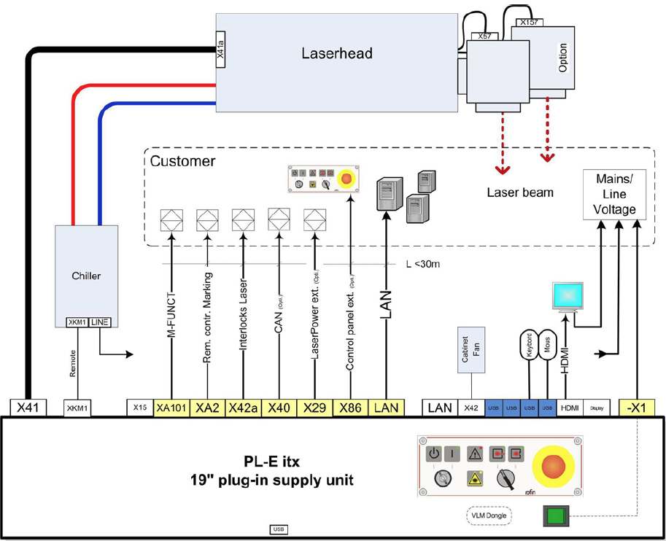
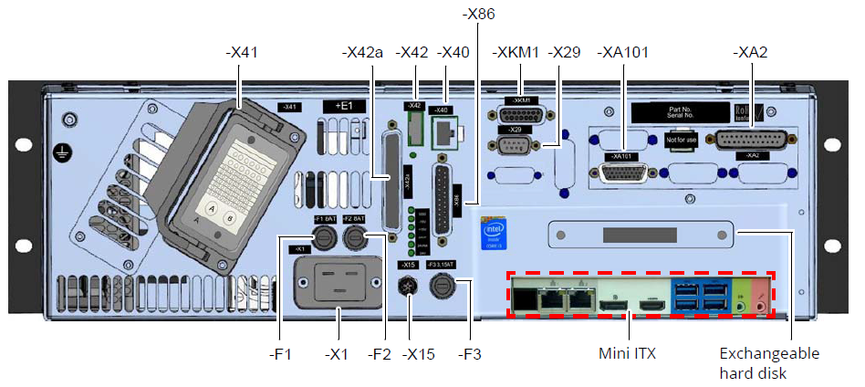
Available Integration Interfaces
Parallel I/O for PLC (real-time)
LAN (TCP/IP) for PC (high-level protocol, no real-time)
Industrial Ethernet to connect external fieldbus couplers
Profibus and Profinet via external fieldbus coupler
CAN-Bus for I/O extension and certain CANopen devices
Interface for safety interlocks (shutter / EMO)
Interface for external operator panel
Interface for external power sensor
RS-232 via USB adapter
supply unit

Slide 23
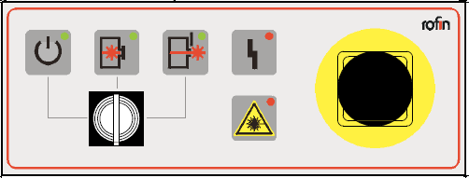
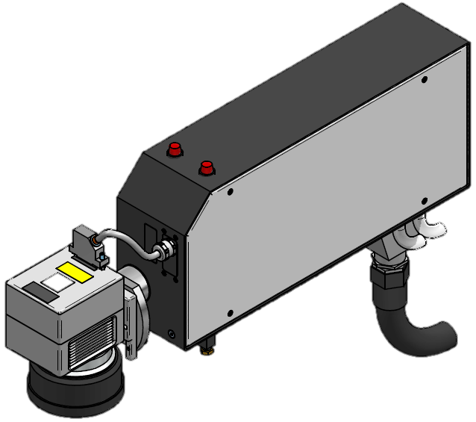
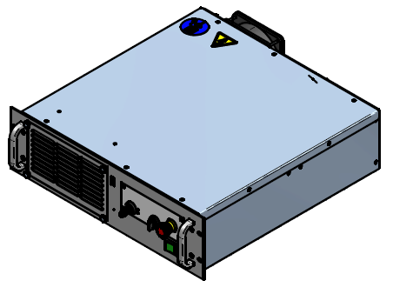
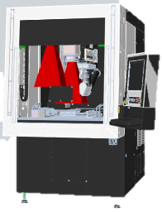


Laser Marker Control Concept
Software
SUPPLY UNIT
Optional Operator Panel (external)
Marking layout and job file is defined by VLM software (vector and bitmap graphics)
One software for all Coherent laser markers
Powerful graphics editor for marking layouts
Manual operation of laser marker
Laser marker control by VMC software
One software for all Coherent laser markers
Perpares data for real-time processing by ALI board
Server for communication with host (machine or factory)
Advanced automation features (marking on the fly, 3D freeform marking, vision system …)
Laser marker configuration setting and testing is done with Laser Console software
Setting of laser power, frequency, first-pulse suppression
Configuration of M-Functions (ALI-Board, CAN extension)
Configuration of axes as needed by marking job
Diagnostics screen
Power Supply
PC
Laser
Operator Panel
Scanner Control
Laser Control
Active Laser Interface (ALI-Board)
ITX PC
Windows 10
VLM
VMC
Laser Console
RCU.exe
System data
Laser Source Control (LSC) Board
USB
USB
Parallel I/O
HDD
- Recipes etc.
Data
control
-start
-stop
-load
- …
SUPPLY UNIT
M-Functions
control,
layout,
variable data
USB / LAN
variable data (optional)
control (optional)
VLM
LAN (TCP/IP)
Handling System (PC, SPS)
Laser Marker
Remote Host

Slide 24
Laser Marker Control Concept
Hardware
SUPPLY UNIT
Optional Operator Panel (external)
Power Supply
PC
Laser
Windows 10 PC integrated into supply unit
Mini-ITX *) motherboard (170 mm x 170 mm)
High performance Intel CPU
Ethernet interface (TCP / IP)
External PC optionally possible (can only run VLM)
Space savings in 19“ rack
Active Laser Interface (ALI) board
Proprietary controller card for real-time synchronous scanner and laser operation
Real-time calculation of scanner control signals based on vector graphics or bitmap elements
Parallel interface for real-time marker control and control of machine actuators during marking job
Laser Source Control Board (LSC)
Controls all laser source related functions
Operator Panel
Scanner Control
Laser Control
Active Laser Interface (ALI-Board)
ITX PC
Windows 10
VLM
VMC
Laser Console
RCU.exe
System data
Laser Source Control (LSC) Board
USB
USB
Parallel I/O
HDD
- Recipes etc.
Data
control
-start
-stop
-load
- …
SUPPLY UNIT
M-Functions
control,
layout,
variable data
USB / LAN
variable data (optional)
control (optional)
VLM
LAN (TCP/IP)
Handling System (PC, SPS)
Laser Marker
Remote Host
*) ITX = Integrated Technology eXtended

Slide 25
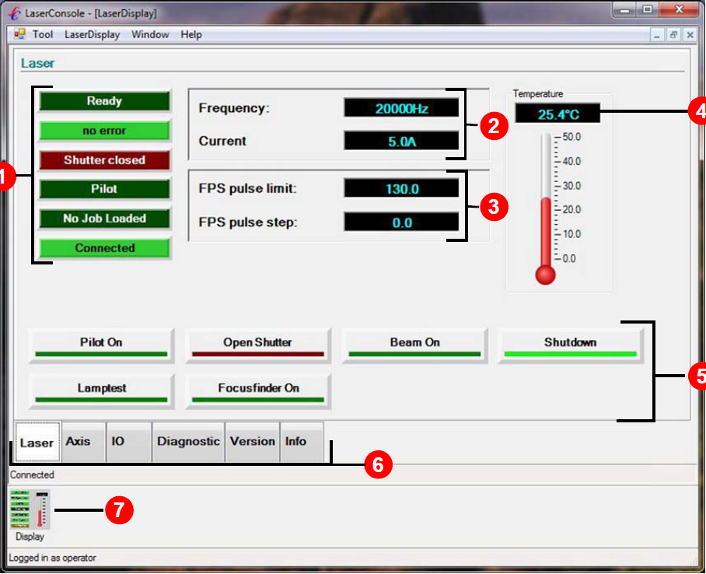
Laser Console Software
Software for Laser Source Control Board
Primarily used for system setup
Allows monitoring / controlling / testing of
Laser parameters / laser status
First-pulse suppression parameters
Shutter open / close
Positioning laser on / off
An unlimited number of axes of the handling system
M-Function I/Os
Error diagnostics
Version numbers of system components
Event log

Slide 26
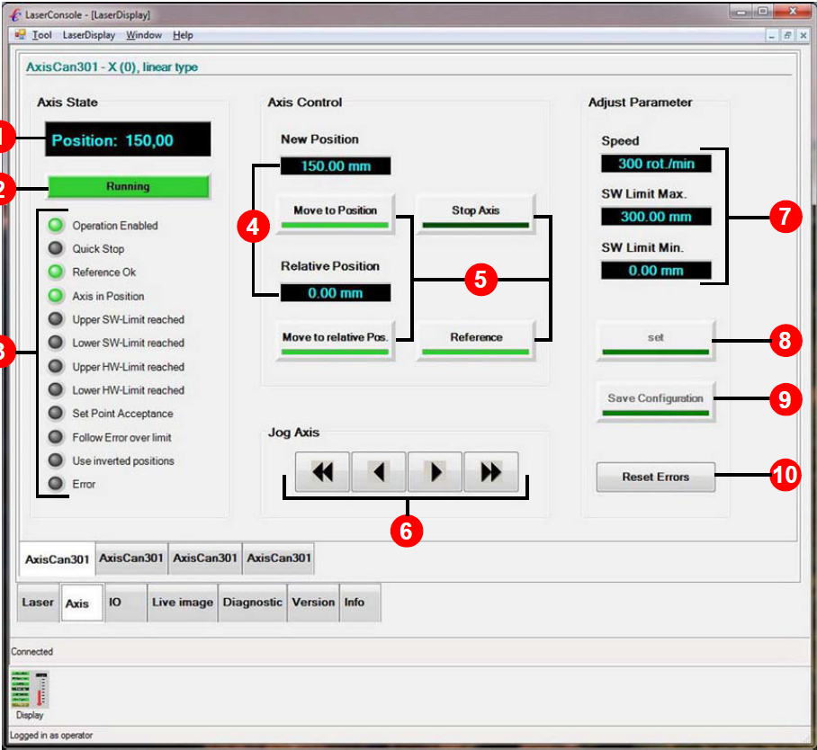

Laser Console Software
Axis / actuators can be controlled via fieldbus or parallel interface
Supported fieldbuses: CANopen, ProfiNet, ProfiBus
Laser Console allows pin mapping of M-Functions

Slide 27



PowerLine E Air Series – At a Glance
Sub-system (class 4) for laser marking
Configurable product :
Standard or high-performance scanners
High-quality f-Theta objectives
Beam expander with fixed or variable expansion factor
Parallel IO, Host communication (TCP/IP), CANBus etc.
Optional features:
Positioning laser
Internal power sensor
Fast focus module
Beam splitter / beam switch
Through-the-Lens Alignment
3D freeform marking
Marking on the fly
Supply unit incl. PC (ITX), laser controller, scanner controller, power supply, operator panel, etc.
VLM marking software / Windows 10

Slide 28



PowerLine E Series – At a Glance
Sub-system (class 4) for laser marking
IR, green and UV wavelength
Configurable product :
Standard or high-performance scanners
High-quality f-Theta objectives
Beam expander with fixed or variable expansion factor
Parallel IO, Host communication (TCP/IP), CANBus etc.
Optional features:
Positioning laser
Internal power sensor
Fast focus module
Beam splitter / beam switch
Through-the-Lens Alignment
3D freeform marking
Marking on the fly
Supply unit, external PC and chiller
Water-cooling
VLM marking software / Windows 10
Length of PL E 40 and PL E 25 SHG laser head: 600 mm

Slide 29



PowerLine F Series – At a Glance
Sub-system (class 4) for laser marking
Configurable product :
Standard or high-performance scanners
High-quality f-Theta objectives
Beam expander with fixed or variable expansion factor
Parallel IO, Host communication (TCP/IP), CANBus etc.
Optional features:
Positioning laser
Fast focus module
Beam splitter / beam switch
Through-the-Lens Alignment
3D freeform marking
Marking on the fly
Supply unit incl. PC (ITX), laser controller, scanner controller, power supply, operator panel, etc.
Fully air-cooled. No separate chiller needed.
VLM marking software / Windows 10

Slide 30

PowerLine F Varia Series – At a Glance
Sub-system (class 4) for laser marking
Adjustable pulse width
Configurable product :
Standard or high-performance scanners
High-quality f-Theta objectives
Beam expander with fixed or variable expansion factor
Parallel IO, Host communication (TCP/IP), CANBus etc.
Optional features:
Positioning laser
Fast focus module
Beam splitter / beam switch
Through-the-Lens Alignment
3D freeform marking
Marking on the fly
Supply unit incl. PC (ITX), laser controller, scanner controller, power supply, operator panel, etc.
Fully air-cooled. No separate chiller needed.
VLM marking software / Windows 10

Slide 31



PowerLine E 8 QT– At a Glance
Sub-system (class 4) for laser marking
Matrix 8-355-50 UV laser source
Compact design with many standard features:
180° beam deflection unit
Positioning laser
Mechanical safety shutter
Internal power sensor
Air recirculation and filtering inside critical optical components
Configurable product :
Standard or high-performance scanners
High-quality f-Theta objectives
Beam expander with fixed expansion factor
Parallel IO, Host communication (TCP/IP), CANBus etc.
Fully air-cooled. No separate chiller needed.
Supply unit incl. PC (ITX), laser controller, scanner controller, power supply, operator panel, etc.
VLM marking software / Windows 10

Slide 32
THANK YOU FOR YOUR ATTENTION
www.coherent.com
Notes:
Process speed / repetition rate
Focal distance
Process speed / repetition rate
Focal distance
Process speed / repetition rate
Focal distance
Process speed
Repetition rate & Execution order
Process speed
Repetition rate & Execution order
Repetition rate
Final parameter
Position in the galvo field

